Slide 1
Grade 11 Meeting Class of 2020 Mrs N. Adams Assistant Principal

Slide 2
HACKENSACK HIGH SCHOOL Contact Information
ALWAYS check the HHS website!!!
www.hackensackschools.org/High

Slide 3
HHS Core Admin Team SY 2018-2019
Mr. Montesano, Principal
Mr. King, Assistant Principal, Grade 9
Mr. Avery, Assistant Principal, Grade 10
Mrs. Adams, Assistant Principal, Grade 11
Mrs. Lozano, Assistant Principal, Grade 12

Slide 4
HHS Department Supervisors SY2018-2019
Ms. Espinal: World Languages, Bilingual Ed., ESL.
Ms. Hovsepian: Guidance Dept.
https://www.hackensackschools.org/Page/7468
Mr. Miello: Athletic Director
Mrs. Cavallo: Language Arts/Media
Mr. Del Vechio: Science & STEM
Mr. Spadafino: Mathematics/Business

Slide 5
Support Services
Health Office
Mrs. Hogan/Mrs. DeFina- Nurse
Drop-In- Room 161: Director Johnson
504 Coordinator/Social Worker- Mr. Levy – Guidance
Transition Coordinator/Job Coach Rm.321
SAC Counselor- Mrs. Koonin – Rm. 179

Slide 6
Rules
No Fighting Policy
No Bullying/Harassment/Intimidation Policy
DOORS: Please do not open doors to for anyone. All visitors must sign-in through the single point entry.
IDs
FAILURE TO WEAR Student IDs are to be visible and worn on a school-issued lanyard. Students cannot be in the building without a current and valid office issued ID.
No IPODS or Cell Phones
All electronics must be shut off in school building.
If they are distracting or in use in school they may be confiscated.

Slide 7
Rules
Dress Code
Student attire shall be neat and clean. Clothing shall cover the torso and legs to mid-thigh.
Clothing shall not be transparent, distracting, or disruptive to the school environment.
Tank tops, halters, tube tops, and bathing suits are not permitted. Sweatshirts, warm-up and T-shirts are permitted, if they are not torn and if they are not cut, tied or hemmed to expose the midriff. No exposure of undergarments or buttocks.
Except for religious and/or cultural purposes, head coverings may not be worn in school.
Students attending any school functions, during school hours, will not be permitted to participate unless they are attired in conformity with this policy.

Slide 8
HIB- Definition
Harassment, Intimidation or Bullying”, better known as H.I.B. is any gesture, written, verbal or physical act, or any electronic communication that is reasonably perceived as being motivated by any actual or perceived characteristic such as:
Race
Color
Religion
Ancestry
National origin
Gender
Sexual orientation
Gender identity and expression
Mental, physical or sensory disability
Any distinguishing characteristic

Slide 9
HIB
H.I.B. could be a single incident or a series of incidents that:
Substantially disrupts or interferes with the orderly operation of the school or the rights of other students.
A reasonable person should know will have the effect of physically or emotionally harming a student
Damage the student’s property or places a student in reasonable fear of physical or emotional harm to his/her person or damage to his/her property
Has the effect of insulting or demeaning any student or group of students
Creates a hostile educational environment for the student by interfering with a student’s education; or by severely/pervasively causing physical/emotional harm to the student.

Slide 10
Discipline Procedures
Teacher Detention
Teachers may assign before or after school detention for minor misbehavior, lateness to class or violation of classroom rules.
Central Detention- Cafeteria
Monday – Thursday: 2:40 p.m.- 3:40 p.m., Non-attendance at Central Detention may result in additional consequences.
Bring your books, homework, assignments and something to read when you complete classwork.

Slide 11
Discipline Procedures
Saturday School- Room 212
Saturday 8 a.m. through 12 p.m.
Arrive no later than 8:00a.m. – Students arriving late will not be admitted.
Bring your books, homework, assignments and something to read when you complete classwork.
In School Suspension ISS
Monday through Friday 8am – 3pm.
A counseling component has been embedded into the In-School Suspension.
Bring your books, homework, assignments and something to read when you complete classwork.

Slide 12
Security Procedures
Fire
Follow teacher instructions.
Follow signs for fire drill.
Evacuation
Follow teacher instructions.
Report to assigned areas and to teacher responsible.
Report to class you are going to when changing periods.
Lockdown
Follow teacher instructions.
Remain silent.

Slide 13
Guidance
GPA
A/A+= 4.0
B/B+= 3.0
C/C+= 2.0
D/D+= 1.0
F = 0
Scheduling-
Choose electives in which you have an interest and which may lead to a possible college major or career

Slide 14
Graduation Requirements
4 years- Physical Education
3 semesters- Health
1 semester- Driver’s Education
4 years- English
3 years- Mathematics
Algebra 1
Geometry
Algebra 2
3 years- Science
Biology
Chemistry
Physics
3 years- History
US I
US II
World
1 year- World Language
1 year- Personal Finance or Business Elective
1 year- Fine, Practical or Performing Art
PARCC Exam 9th, 10th and 11th grades

Slide 15
Attendance
16 Unexcused absences from school and/or individual classes.
*5 lates = 1 Unwaived Absence
Period 2 and Period 9 are troublesome.
Arriving 20 minutes or more late will be charged with an unwaived absence.

Slide 16
Athletics
Athletics- Room#184
Athletic Director: Mr. Miello
HHS Eligibility
Successful completion of 27.5 credits will make you eligible Sophomore year.
A minimum of 27.5 credits is required each subsequent year to maintain eligibility.
Any student/athlete shall maintain a 2.0 Grade Point Average or be subject to a tutorial program while in season.
NCAA Eligibility
Maintain 2.3
Take NCAA approved classes

Slide 17
Student Activities
Student Activities- Mr. Avery
Room# 223
Get involved in at least 2 clubs/organizations
Student Government- Room 186
National Honor Society
FBLA
FEA
Community Service
Document hours!!!! Don’t wait for the last minute!!!

Slide 18
Upcoming Events
School Begins 9/5
12:30 Dismissal
Back To School Night
September 26, 2018; 6:45pm
Parent Meeting 9/13

Slide 20
HHS Question and Answer

Slide 21
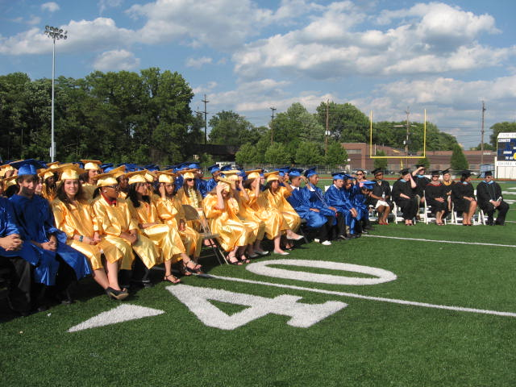
Doing The Little Things…
…Will Lead To Academic Success

Slide 22
Make The 2018-2019 School Year, the best year ever!! COMET PRIDE!!!!

