Slide 1
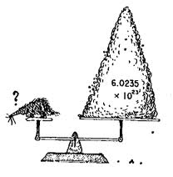
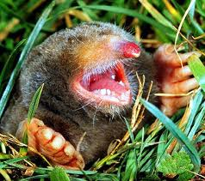
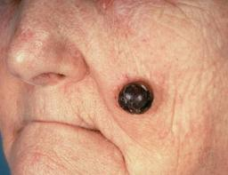
The Mole
The most important concept in chemistry

Slide 2
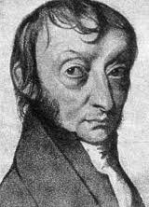
The mole
The term ‘mole’ comes from the word ‘molecule’.
The concept of the mole was created by Amadeo Avogadro.

Slide 3
The mole
Avogadro was trying to develop a system for counting atoms using the volume of gas.
He calculated that there are 6.02 x 10²³ gas particles in a container that has a volume of 22.4 L

Slide 4
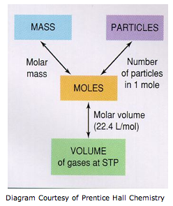
The Mole
The mole lets us perform calculations involving the mass of atoms or molecules, the # of particles, or the volume that the particles occupy.

Slide 5
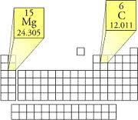
The Mole
Mole to mass conversions;
The average atomic mass of an element is the mass of 1 mole of atoms. 1 mole of carbon atoms has a mass of 12.01 grams.
A more appropriate term for this mass is to call it the ‘molar mass’.

Slide 6
The Mole
Molar Mass
The molar mass of a compound or diatomic molecule is calculate by adding all of the elements that make up the compound.
The molar mass of O₂ is (16.00 grams) x 2 = 32.oo grams / mole

Slide 7
The Mole
Calculate the molar mass of;
NaCl
Al₂O₃
Ca(C₂H₃O₂)₂

Slide 8
The Mole
Converting mass to moles
Use Dimensional Analysis
Use the molar mass as a conversion factor to cancel out grams and convert into moles.
Convert 10.0 grams of hydrogen gas into moles.

Slide 9
The Mole
Converting moles to mass;
Use the molar mass as a conversion factor to cancel out moles and convert into grams.
Convert 0.030 moles of LiF into grams.

Slide 10
The Mole
Using the mole to convert into # of particles;
Since 1 mole = 6.02 x 10²³ particles, we can use it as a conversion factor to cancel out units.
Convert 0.10 moles of iron atoms into number of atoms.

Slide 11
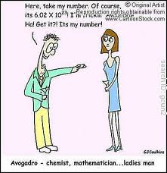
The Mole
Molar Volume Conversions
Avogadro calculated that the volume of 1 mole of gas particles would occupy a volume of 22.4L. That is, 1 mole of a gas = 22.4 L (@ STP)

Slide 12
The Mole
Calculate the volume of 0.85 moles of Argon gas.

Slide 13
The Mole
Calculate the mass of 3.0 L of carbon dioxide (@ STP).

Slide 14
The Mole
Mixed example problems;
Calculate the number of atoms in 0.45 moles of carbon.
Calculate the mass of 30.00 moles of methane (CH₄).

Slide 15
The Mole
Multistep mole conversion problems;
Calculate the volume of 10.0 grams of CO₂ at STP.
How many atoms would a 1.00 gram sample of tin contain.

