Slide 1
Given:
Constructions “Constructing congruent segments”
•
•
A
B
Step 1. Draw a reference line with your straight edge. Place a reference point to indicate where your new segment starts on the line and label this point Q.
Step 2. Place the compass at point A and adjust the compass setting so that the pencil is at point B.

Slide 2
•
•
A
B
Step 3: Using that setting, place the compass point at Q and draw and arc that intersects the lin. Label the point of intersection R.

Slide 3
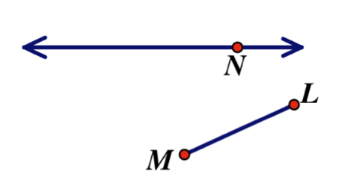
Constructing Congruent Segments
Try This!
Construct a Congruent Segment on the horizontal line.
1)

Slide 4
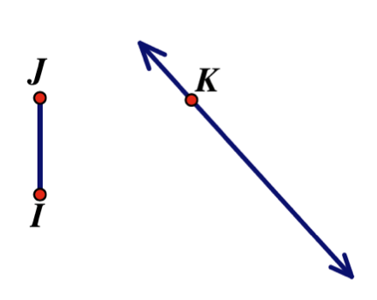
Constructing Congruent Segments
Construct a Congruent Segment on the slanted line.
2)

