Slide 1
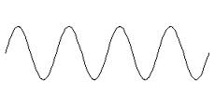
Electronic Structure
Electromagnetic Radiation
Energy emitted from atoms that can be described as behaving like a wave.
Waves are created from oscillating particles moving at a constant speed.
The moving particle of electromagnetic radiation is called a photon.

Slide 2
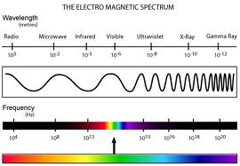
Electronic Structure
Electromagnetic Radiation
Electromagnetic Spectrum – Shows all of the different types of energy that behaves like a wave.

Slide 3
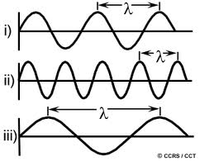
Electronic Structure
Electromagnetic Radiation
Wavelength (λ) – the distance between
two crests of a wave.

Slide 4
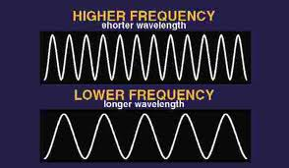
Electronic Structure
Electromagnetic Radiation
Frequency (ν) – the number of crests that pass a certain point per second.
The unit for
Frequency is
the Hertz (Hz)

Slide 5
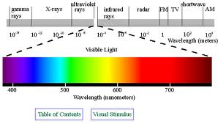
Electronic Structure
Electromagnetic Radiation
Electromagnetic Spectrum
Visible Light – A small section of the entire electromagnetic spectrum.

Slide 6
Electronic Structure
Atomic Emission Spectra
What happens when a hydrogen atom absorbs energy?

Slide 7
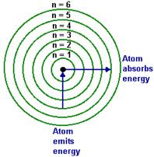
Electronic Structure
Atomic Emission Spectra
What happens then an hydrogen atom absorbs energy?

Slide 8
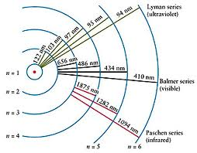
Electronic Structure
Atomic Emission Spectra
What happens then an hydrogen atom absorbs energy?

Slide 9
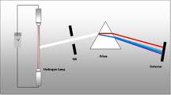
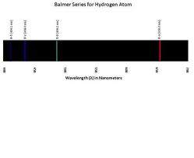
Electronic Structure
Atomic Emission Spectra
What happens then an hydrogen atom absorbs energy?

Slide 10
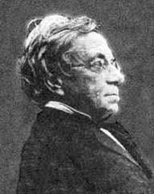
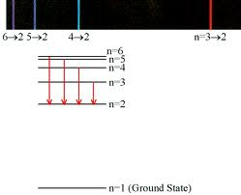
Electronic Structure
Atomic Emission Spectra
The Balmer Series (Johann Balmer) – Individual wavelengths of visible light produced when excited electrons return to the 2nd energy level (Quantum).

Slide 11
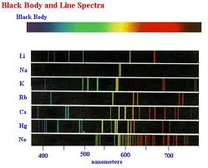
Electronic Structure
Atomic Emission Spectra
Other Elements produce more complex emission lines. Why?

Slide 12
Electronic Structure
Electromagnetic Radiation
What is the relationship between frequency and wavelength?
Speed of Light = Wavelength x Frequency
c = λ x ν
c = 3.00 x 10⁸ m/s

Slide 13
Electronic Structure
Electromagnetic Radiation
Calculate the frequency of a type of electomagnetic radiation that has a wavelength of 6.0 x 10⁻⁵ m.

Slide 14
Electronic Structure
Electromagnetic Radiation
Calculate the frequency of a type of electomagnetic radiation that has a wavelength of 760 nm.

Slide 15
Electronic Structure
Electromagnetic Radiation
Wavelength versus Frequency – Since electromagnetic radiation travels at the speed of light, we can relate wavelength and frequency with an equation.
Speed of light = wavelength x frequency
c = λ × ν (c = 3.0 x 10⁸ m/s)

Slide 16
Electronic Structure
Electromagnetic Radiation
Calculate the frequency of electromagnetic radiation with a wavelength of 7.0 x 10⁻⁷ m.
c = λ × ν (c = 3.0 x 10⁸ m/s)

Slide 17
Electronic Structure
Electromagnetic Radiation
Calculate the wavelength of electromagnetic radiation that has a frequency of 3.0 x 10¹⁴ Hz.
c = λ × ν (c = 3.0 x 10⁸ m/s)

Slide 18
Electronic Structure
Electromagnetic Radiation
What is the wavelength of electromagnetic radiation that has a frequency of 6.0 x 10¹⁴ Hz?

Slide 19
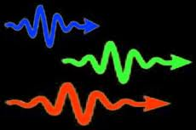
Electronic Structure
Photons of Electromagetic Radiation
A photon is a ‘packet of energy’.
Just like a cell is the smallest unit of a living organism, a photon is the smallest unit of electromagnetic radiation.

Slide 20
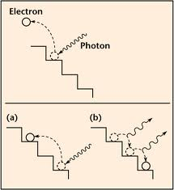
Electronic Structure
Photons of Electromagetic Radiation
When an electron absorbs energy and moves to a higher energy level, it falls back down and releases a photon of electromagnetic energy in the process.

Slide 21
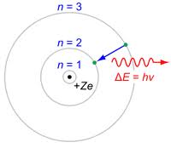
Electronic Structure
Photons of Electromagetic Radiation
We can calculate the energy that a photon would have by using the equation E = h.v
E = energy (J)
h (plank’s constant) = 6.626 x 10⁻³⁴ J.s
v = frequency (Hz)

