Slide 1
Seedfolks
Chapter 1-5 Vocabulary

Slide 2
peer(pg. 1)
Verb.
to look narrowly or searchingly; glare

Slide 3
Turn and talk to your shoulder partner and discuss a reason why you might peer over a fence.

Slide 4
Quick Illustrations Turn and talk Share

Slide 5
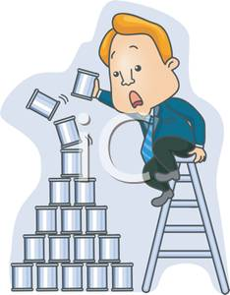
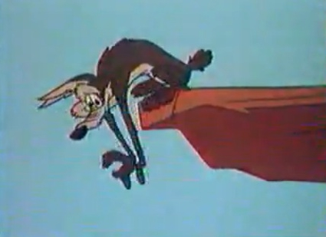
teeter (pg. 2)
Verb –
To move unsteadily; to tip over; wobble

Slide 6
Turn and talk to your face partner and discuss something dangerous to teeter on the side of a cliff.

Slide 7
Quick Illustrations Turn and talk Share

Slide 8
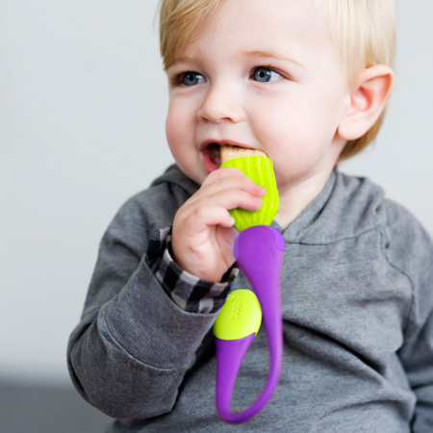
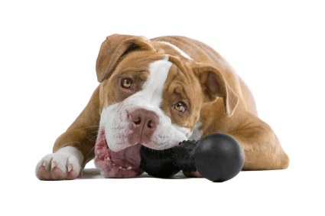
gnaw (pg. 2)
Verb –
To bite or chew persistently; to wear away by biting/nibbling

Slide 9
Turn and talk to your shoulder partner and discuss one food you would gnaw on.

Slide 10
Quick Illustrations Turn and talk Share

Slide 11
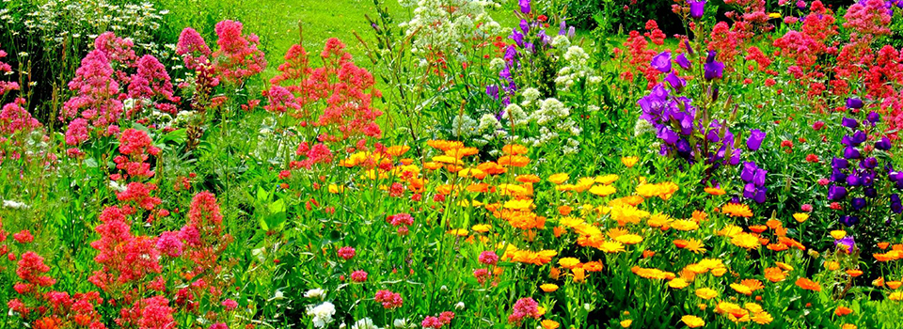
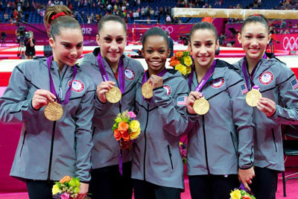
thrive (pg. 3)
Verb –
to prosper; grow or develop vigorously; do well

Slide 12
Turn and talk to your face partner and discuss one area/activity that you thrive in and why.

Slide 13
Quick Illustrations Turn and talk Share

Slide 14
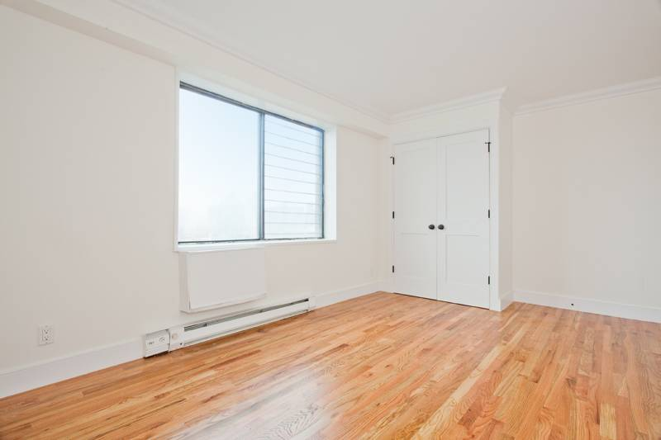
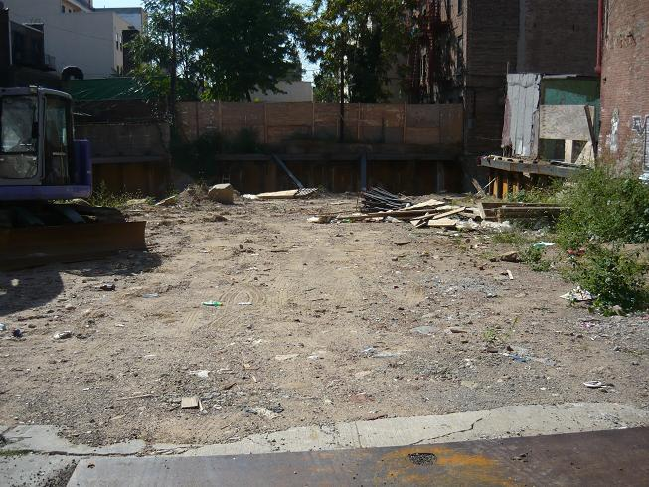
vacant (pg. 4)
Adj. –
not in use; empty; having no contents

Slide 15
Turn and talk to your shoulder partner about reasons why a lot may be vacant.

Slide 16
Quick Illustrations Turn and talk Share

Slide 17
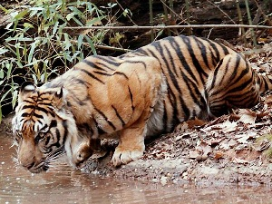
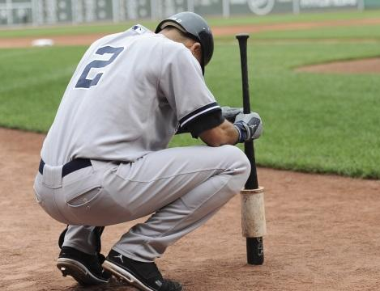
crouch (pg. 6)
Verb –
to stoop or bend low, close to the ground

Slide 18
Get out of your chair and give the best crouching stance.

Slide 19
Quick Illustrations Turn and talk Share

Slide 20
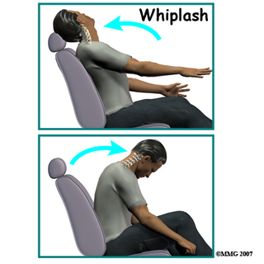
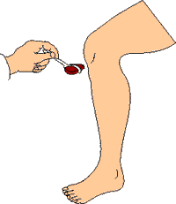
jerk (pg. 9)
Verb –
To move with a quick, sharp motion; move spastically

Slide 21
Turn and talk to your face partner about a reason why you may involuntarily jerk your body.

Slide 22
Quick Illustrations Turn and talk Share

Slide 23
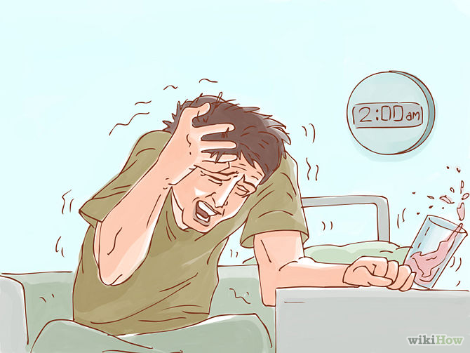
moan (pg. 12)
Noun –
long, low sound made by a person experiencing physical or mental suffering

Slide 24
Turn and talk to your shoulder partner about an injury which would produce the biggest moan.

Slide 25
Quick Illustrations Turn and talk Share

Slide 26
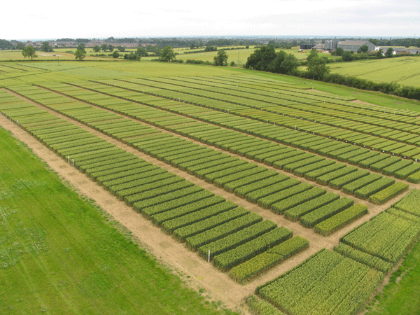
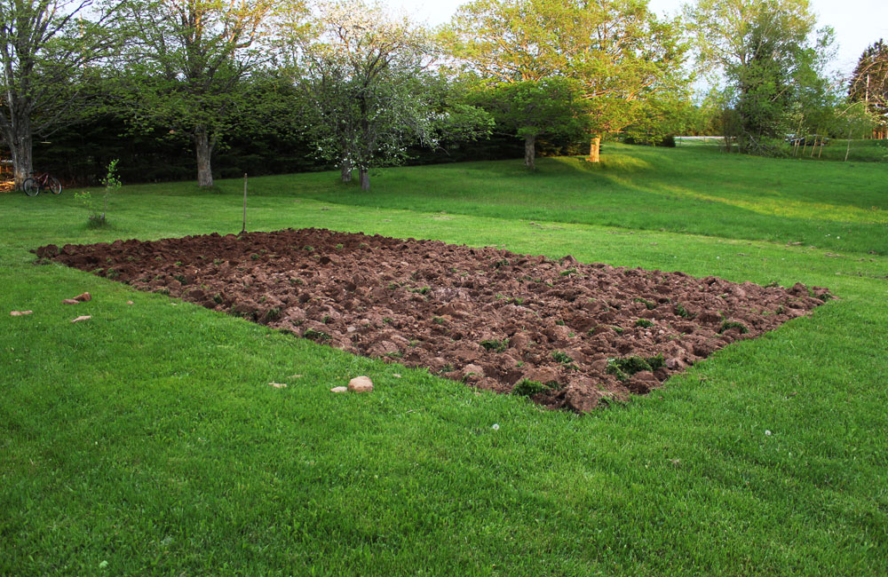
plot (pg. 12)
Noun –
plot small area of land; small space

Slide 27
Turn and talk to your face partner about a crop you would plant on a plot of land, in order to sell it for money.

Slide 28
Quick Illustrations Turn and talk Share

Slide 29
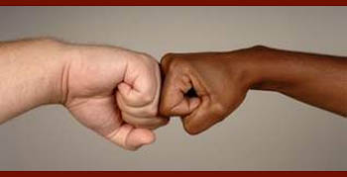
gesture (pg. 15)
Noun –
movement or position of the head, hand, and/or arm to express an idea or meaning

Slide 30
Turn to your shoulder partner and gesture for them to come closer.

Slide 31
Quick Illustrations Turn and talk Share

