Slide 1
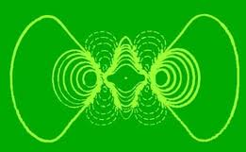
Chapter 3 (part 2) – Electronic Structure
Question: How exactly are electrons arranged around the nucleus of the atom?
Answer: It’s pretty complicated.

Slide 2
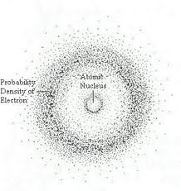
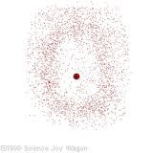
Electronic Structure
The Electron Cloud Model – Erwin Schrodinger (1926)
Also called the Quantum Mechanical Model.

Slide 3
Electronic Structure
The Electron Cloud Model
The electrons are arranged around the nucleus of the atom almost like a map of the United States.
The entire area is the country. A smaller portion is called a state, even smaller is the county, then the town, street, and finally the street address.

Slide 4
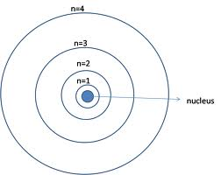
Electronic Structure
The Electron Cloud Model
Principle Quantum (n)
A large area around the nucleus of the atom where electrons are located.
A Principle Quantum is represented by a ring around the nucleus of the atom.

Slide 5
Electronic Structure
The Electron Cloud Model
Principle Quantum (n)
There are 7 of these quantums located around the nucleus of the atom
A Principle Quantum can also be called an energy level.

Slide 6
Electronic Structure
The Electron Cloud Model
Sublevels
Sublevels are found within the quantums.
There 4 types of sublevels (s, p, d, and f)

Slide 7
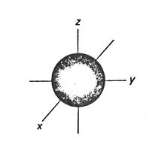
Electronic Structure
The Electron Cloud Model
s-sublevel
Spherical shape
Contains only 1 orbital
It can hold a maximum of 2
electrons.

Slide 8
Electronic Structure
The Electron Cloud Model
p-sublevel
Has a peanut shape to it.
Contains 3 orbitals
It can hold a maximum of 6
electrons.

Slide 9
Electronic Structure
The Electron Cloud Model
d-sublevel
Has a daisy shape to it.
Contains 5 orbitals
It can hold a maximum of 10
electrons.

Slide 10
Electronic Structure
The Electron Cloud Model
f-sublevel
Has a funky shape to it.
Contains 7 orbitals
It can hold a maximum of 14
electrons.

Slide 11
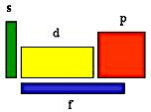
Electronic Structure
The Electron Cloud Model
s, p, d, and f sublevels

Slide 12
Electronic Structure
The Electron Cloud Model
s, p, d, and f sublevels
This version of the Periodic Table shows where the last electron will be located for each element.
Sodium’s last electron is in the s-sublevel
Helium’s last electron is
in the s-sublevel.

Slide 13
Electronic Structure
The Electron Cloud Model
Electron orbitals
Regions within the sublevels where electrons are found.
Each orbital can hold a maximum of 2 electrons.

Slide 14
Electronic Structure
The Electron Cloud Model
Electronic Structure
Quantum → sublevel → orbital → electron

Slide 15
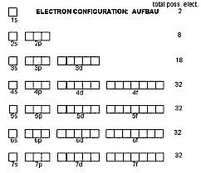
Electronic Structure
Orbital Diagrams
A diagrams that shows how the electrons are arranged within the quantums, sublevels, and orbitals.

Slide 16
Electronic Structure
Orbital Diagrams
Quantum | Sublevel(s) | # of Orbitals | Max. # of electrons
1 | s | 1 | 2
2 | s, p | 5 | 8
3 | s, p, d | 9 | 18
4 | s, p, d, f | 16 | 32
5 | s, p, d, f | 16 | 32
6 | s, p, d, f | 16 | 32
7 | s, p, d, f | 16 | 32

Slide 17
Electronic Structure
Orbital Diagrams – A representation of how electrons are arranged around the atom.
Each line represents an orbital and an arrow represents an electron.
Orbital diagram of hydrogen:
H: ____
1s

Slide 18
Electronic Structure
Orbital Diagrams
We must first establish the order of the sublevels from lowest energy to the highest energy.
Lowest Highest
Energy energy
1s²2s²2p⁶3s²3p⁶4s²3d¹⁰4p⁶5s²4d¹⁰5p⁶6s²4f¹⁴5d¹⁰6p⁶7s²5f¹⁴6d¹⁰7ps⁶

Slide 19
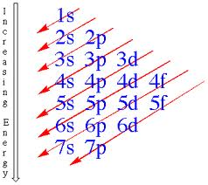
Electronic Structure
Orbital Diagrams
There is a trick to make it easier to remember the filling order of the sublevels.
1s²2s²2p⁶3s²3p⁶4s²3d¹⁰4p⁶5s²4d¹⁰5p⁶6s²4f¹⁴5d¹⁰6p⁶7s²5f¹⁴6d¹⁰7ps⁶

Slide 20
Electronic Structure
Orbital Diagrams
He: ____
1s
Li: ____ ____
1s 2s

Slide 21
Electronic Structure
Orbital Diagrams
Be: ____ ____
1s 2s
B: __ __ __ __ __
1s 2s 2p

Slide 22
Electronic Structure
Orbital Diagrams
C: __ __ __ __ __
1s 2s 2p
N: __ __ __ __ __
1s 2s 2p

Slide 23
Electronic Structure
Orbital Diagrams
Mg:
S:
Fe:

Slide 24
Electronic Structure
Electron Configurations
They are similar to orbital diagrams but the electrons are written as exponents, not arrows.
H: 1s¹
He: 1s²
Li: 1s² 2s¹

Slide 25
Electronic Structure
Electron Configurations
They are similar to orbital diagrams but the electrons are written as exponents, not arrows.
Be: 1s² 2s²
B: 1s² 2s² 2p²
C: 1s² 2s² 2p³

Slide 26
Electronic Structure
Electron Configurations
Write the electron configurations for the following elements;
Ne:
Ca:
Zn:

Slide 27
Electronic Structure
Exceptions in Electron Configurations
Chromium (Cr), Molybdenum (Mo), Copper (Cu), and Silver (Ag)
Cr:
Mo:

Slide 28
Electronic Structure
Exceptions in Electron Configurations
Chromium (Cr), Molybdenum (Mo), Copper (Cu), and Silver (Ag)
Cu:
Ag:

Slide 29
Electronic Structure
Electron Configurations
Writing electron configurations using the core method.
Na: 1s² 2s² 2p⁶ 3s¹
The green electrons represent the element neon. So we can put the symbol of neon in brackets and write the electron configuration of sodium as follows;
Na: [Ne] 3s¹

Slide 30
Electronic Structure
Electron Configurations
Writing electron configurations using the core method.
Na: 1s² 2s² 2p⁶ 3s¹
The only element that can be placed in the brackets is the last noble gas that was passed.
Na: [Ne] 3s¹

Slide 31
Electronic Structure
Electron Configurations
Writing electron configurations using the core method for the following elements;
P: 1s² 2s² 2p⁶ 3s² 3p³ → [Ne] 3s² 3p³
N:
Cl:

Slide 32
Electronic Structure
Electron Configurations of Ions
Ions are atoms with an electrical charge because they have either more or less electrons than the neutral atom.
Na⁺¹: 1s²2s²2p⁶ (Looks like Neon)

Slide 33
Electronic Structure
Electron Configurations of Ions
How can we predict the electrical charge of an element?
Group 1 = +1
Group 2 = +2
Group 3 = +3
Group 4 = +4/-4
Group 5 = -3
Group 6 = -2
Group 7 = -1
Group 8 = 0

Slide 34
Electronic Structure
Electron Configurations of Ions
Mg⁺²: 1s²2s²2p⁶ (Looks like Neon)
Al⁺³: 1s²2s²2p⁶ (Looks like Neon)
O⁻²: 1s²2s²2p⁶ (Looks like Neon)
F⁻¹: 1s²2s²2p⁶ (Looks like Neon)

Slide 35
Electronic Structure
Electron Configurations of Ions
Fe⁺²:
Fe⁺³:
O⁻²:
N⁻³:

Slide 36
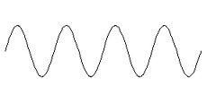
Electronic Structure
Electromagnetic Radiation
Energy emitted from atoms that can be described as behaving like a wave.
Waves are created from oscillating particles moving at a constant speed.
The moving particle of electromagnetic radiation is called a photon.

Slide 37
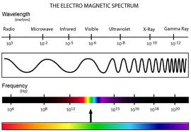
Electronic Structure
Electromagnetic Radiation
Electromagnetic Spectrum – Shows all of the different types of energy that behaves like a wave.

Slide 38
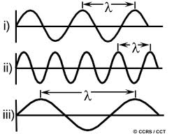
Electronic Structure
Electromagnetic Radiation
Wavelength (λ) – the distance between
two crests of a wave.

Slide 39
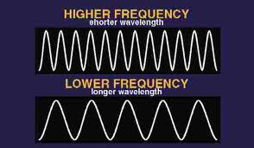
Electronic Structure
Electromagnetic Radiation
Frequency (ν) – the number of crests that pass a certain point per second.
The unit for
Frequency is
the Hertz (Hz)

Slide 40
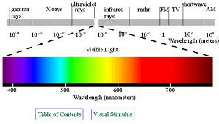
Electronic Structure
Electromagnetic Radiation
Electromagnetic Spectrum
Visible Light – A small section of the entire electromagnetic spectrum.

Slide 41
Electronic Structure
Atomic Emission Spectra
What happens when a hydrogen atom absorbs energy?

Slide 42
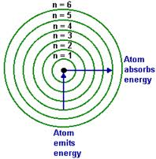
Electronic Structure
Atomic Emission Spectra
What happens then an hydrogen atom absorbs energy?

Slide 43
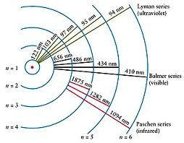
Electronic Structure
Atomic Emission Spectra
What happens then an hydrogen atom absorbs energy?

Slide 44
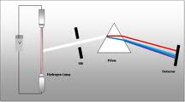
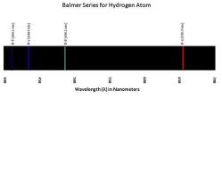
Electronic Structure
Atomic Emission Spectra
What happens then an hydrogen atom absorbs energy?

Slide 45
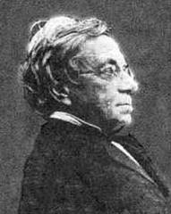
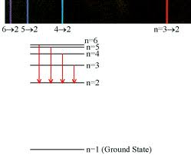
Electronic Structure
Atomic Emission Spectra
The Balmer Series (Johann Balmer) – Individual wavelengths of visible light produced when excited electrons return to the 2nd energy level (Quantum).

Slide 46
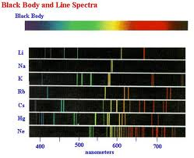
Electronic Structure
Atomic Emission Spectra
Other Elements produce more complex emission lines. Why?

Slide 47
Electronic Structure
Electromagnetic Radiation
What is the relationship between frequency and wavelength?
Speed of Light = Wavelength x Frequency
c = λ x ν
c = 3.00 x 10⁸ m/s

Slide 48
Electronic Structure
Electromagnetic Radiation
Calculate the frequency of a type of electomagnetic radiation that has a wavelength of 6.0 x 10⁻⁵ m.

Slide 49
Electronic Structure
Electromagnetic Radiation
Calculate the frequency of a type of electomagnetic radiation that has a wavelength of 760 nm.

Slide 50
Electronic Structure
Electromagnetic Radiation
Wavelength versus Frequency – Since electromagnetic radiation travels at the speed of light, we can relate wavelength and frequency with an equation.
Speed of light = wavelength x frequency
c = λ × ν (c = 3.0 x 10⁸ m/s)

Slide 51
Electronic Structure
Electromagnetic Radiation
Calculate the frequency of electromagnetic radiation with a wavelength of 7.0 x 10⁻⁷ m.
c = λ × ν (c = 3.0 x 10⁸ m/s)

Slide 52
Electronic Structure
Electromagnetic Radiation
Calculate the wavelength of electromagnetic radiation that has a frequency of 3.0 x 10¹⁴ Hz.
c = λ × ν (c = 3.0 x 10⁸ m/s)

Slide 53
Electronic Structure
Electromagnetic Radiation
What is the wavelength of electromagnetic radiation that has a frequency of 6.0 x 10¹⁴ Hz?

Slide 54
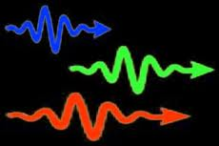
Electronic Structure
Photons of Electromagetic Radiation
A photon is a ‘packet of energy’.
Just like a cell is the smallest unit of a living organism, a photon is the smallest unit of electromagnetic radiation.

Slide 55
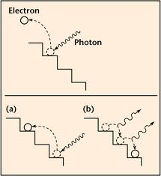
Electronic Structure
Photons of Electromagetic Radiation
When an electron absorbs energy and moves to a higher energy level, it falls back down and releases a photon of electromagnetic energy in the process.

Slide 56
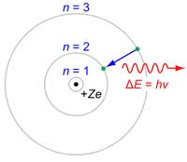
Electronic Structure
Photons of Electromagetic Radiation
We can calculate the energy that a photon would have by using the equation E = h.v
E = energy (J)
h (plank’s constant) = 6.626 x 10⁻³⁴ J.s
v = frequency (Hz)

