Slide 1
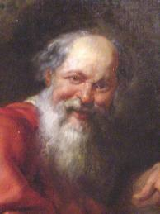
Chapter 3 – The Development of the Atomic Model
Evolution of the Atomic Model
Democritus (400 bc)
First to conceptualize the atom.
He thought that matter was composed
of tiny particles.
The word atom means ‘indivisible’.

Slide 2
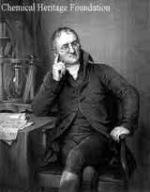
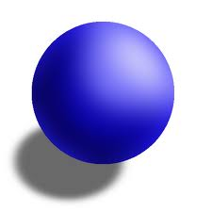
Atoms, Molecules, and Ions
Evolution of the Atomic Model
John Dalton (1700’s)
Creates the Law of Definite Composition..
States that atoms look like very small
spheres.
He thinks that they are hard and are
electrically neutral.

Slide 3
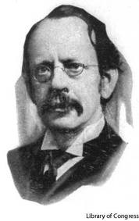
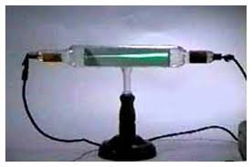
Atoms, Molecules, and Ions
Evolution of the Atomic Model
J.J. Thomson (1800’s)
Using a Crooke’s Tube, he observes a Cathode Ray.

Slide 4
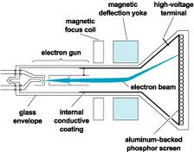
Atoms, Molecules, and Ions
Evolution of the Atomic Model
J.J. Thomson (Late 1800’s)
Theorized that the gream beam of light was actually made of small particles.
He discovered that the particles had a negative electric charge.

Slide 5
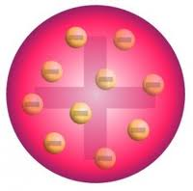
Atoms, Molecules, and Ions
Evolution of the Atomic Model
J.J. Thomson (Late 1800’s)
Thomson develops the ‘Plum Pudding’ model of the atom.
An electrically positive sphere with small negative charges (electrons) dispersed throughout it.

Slide 6
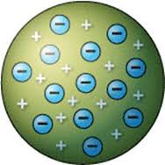
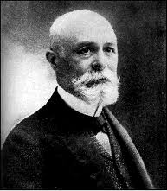
Atoms, Molecules, and Ions
Evolution of the Atomic Model
Eugen Goldstein (Late 1800’s)
At about the same time Thomson discovered the electron, Goldstein discovered the proton in the same way.
The proton was a positively charged partical that was 2000 times heavier than the electron.

Slide 7
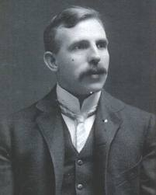
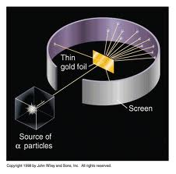
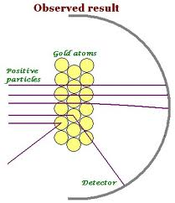
Atoms, Molecules, and Ions
Evolution of the Atomic Model
Ernest Rutherford
Rutherford conducts the Gold Foil Experiment in 1913..

Slide 8
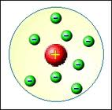
Atoms, Molecules, and Ions
Evolution of the Atomic Model
Ernest Rutherford
Made the following conclusions about the atom;
The center of the atom consists of a hard and dense core called the nucleus.
The nucleus is have a positive electrical charge.
All of the mass of the atom is concentrated in the nucleus.
The electrons are are located around the nucleus.

Slide 9
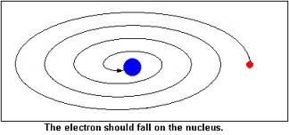
Atoms, Molecules, and Ions
Evolution of the Atomic Model
Ernest Rutherford
But there was a problem -

Slide 10
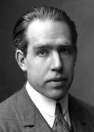
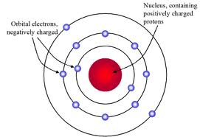
Atoms, Molecules, and Ions
Evolution of the Atomic Model
Niels Bohr (1920’s)
Proposed that the electrons are ‘stuck’ in paths that orbit around the atomic nucleus.
He called these paths ‘orbitals’.

Slide 11
Atoms, Molecules, and Ions
Evolution of the Atomic Model
Niels Bohr (1920’s)
But there is another problem –
Electrons that move in circular paths should
emit light.
So why don’t atoms glow?

Slide 12
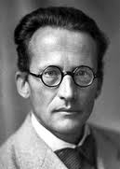
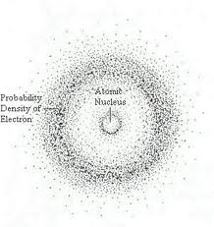
Atoms, Molecules, and Ions
Evolution of the Atomic Model
Erwin Schoedinger (1940’s)
Schroedinger proposes the Electron Cloud Model.
The electrons are moving so fast that they appear
as a cloud around the atomic
nucleus.

Slide 13
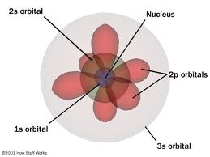
Atoms, Molecules, and Ions
Evolution of the Atomic Model
Erwin Schoedinger (Electron Cloud Model)
The electrons are highly organized within the ‘cloud’.
Electrons are found in regions around the atomic nucleus called Quantums, Sublevels, and Orbitals.

Slide 14
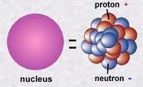
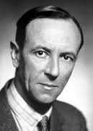
Atoms, Molecules, and Ions
Evolution of the Atomic Model
Sir James Chadwick (1920’s)
Chadwick notices that some atoms of the same elements appear to have different masses.
He discovered electrically neutral particles found in the atomic nucleus which he called neutrons.

Slide 15
Atoms, Molecules, and Ions
The Subatomic Particles
amu (atomic mass unit) – smallest mass of an atom
Particle | Symbol | Electric Charge | Location | Mass
Electron | e⁻ | -1 | Around the nucleus | 1/2000 amu
Proton | P⁺ | +1 | Nucleus | 1 amu
Neutron | n⁰ | 0 | nucleus | 1 amu

Slide 16
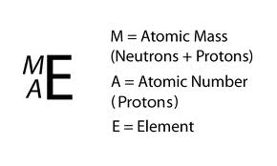
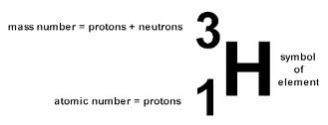
Atoms, Molecules, and Ions
Isotopes
Isotopes are atoms of the same element with a different number of neutrons.
Isotopes have the same chemical and physical properties, but their masses will differ.

Slide 17
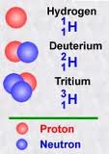
Atoms, Molecules, and Ions
Isotopes
How many protons, neutrons, and electrons does each isotope of hydrogen have?

Slide 18
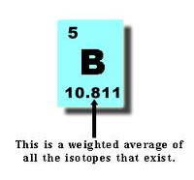
Atoms, Molecules, and Ions
Isotopes
The average atomic mass of an isotope is the weighted average of all isotopes of the element that exist.

Slide 19
Atoms, Molecules, and Ions
Isotopes
Calculating Average Atomic Mass
Since the average atomic mass is a weighted average, we need to know the weight.
The % abundance of an isotope is the number of isotopes present per 100 atoms of the element.

Slide 20
Atoms, Molecules, and Ions
Isotopes
Percent Abundance
99.985% 0.014% 0.001%

Slide 21
Atoms, Molecules, and Ions
Isotopes
Calculating Average Atomic Mass
Average atomic mass = (relative abundance of first isotope)(atomic mass) + (relative abundance of 2nd isotope)(atomic mass) + ….

Slide 22
Atoms, Molecules, and Ions
Isotopes
Calculate the average atomic mass of Hydrogen. H-1 has percent abundance of 99.985%, H-2 is 0.014% , and H-3 is 0.001%.

Slide 23
Atoms, Molecules, and Ions
Ions
Electrically charged atoms due to a loss or gain of an electron(s).
An atom that gains an e⁻ becomes negatively charged.
S + 2e⁻ → S⁻²
Nonmetals tend to gain electrons.

Slide 24
Atoms, Molecules, and Ions
Ions
Negatively charged atoms are called anions.
Write the equation for the formation of the oxygen ion;

Slide 25
Atoms, Molecules, and Ions
Ions
Positively charged atoms are called cations.
Metals tend to form positive ions.
Write the equation for the formation of the strontium ion;

Slide 26
Atoms, Molecules, and Ions
Ions
How can we predict the charge of an ion?
Group 1 = +1
Group 2 = +2
Group 3 = +3
Group 4 = +4 / -4
Group 5 = -3
Group 6 = -2
Group 7 = -1
Group 8 = 0

Slide 27
Atoms, Molecules, and Ions
Ions
What about the Transition Metals?
Although we know they will be positive, we do not know what charge they will form.
But we do know that silver always forms a +1 and zinc always forms a +2.

Slide 28
Atoms, Molecules, and Ions
Naming Ions
Cations: No change in the elements name.
Transition metals need a roman numeral after the symbol to indicate its charge.
Fe⁺³ iron(III)
Co⁺² cobalt(II)
Anions: Substitute an ‘ide’ ending to the name of the element.
S⁻² = sulfide
O⁻² = oxide
Br⁻¹ = bromide

Slide 29
Atoms, Molecules, and Ions
Polyatomic Ions
A group of atoms that carry an overall charge.
Most are negatively charged.
SO₄⁻² (sulfate)
NO₂⁻¹ (nitrate)
ClO₂⁻¹ (chlorite)

Slide 30
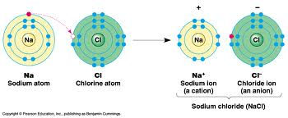
Ionic Bonding
Ionic Compounds are substances that form when a cation and an anion attract and ‘stick’ to each other.
The force that’ glues’ the ions together is an electrostatic interaction. In other words, opposite charges attract.

Slide 31
Ionic Bonding
When a cation and an anion are attracted to each other, an ionic bond has formed.

Slide 32
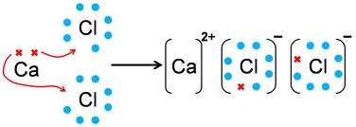
Ionic Bonding
What happens when a calcium ion and a chloride ion come together? What do you think the ratio of cations to anions would be?

Slide 33
Ionic Bonding
Rules for forming and writing ionic compounds;
The sum of the positive and negative charges has to equal zero. Ionic compounds are neutral.
The cation is written first in the formula.
A subscript is used to tell us how many of each atom is in the ionic compound.
Na₂O

Slide 34
Ionic Bonding
Write the chemical formula for the ionic compound that will form from the following elements;
Magnesium and sulfur
Potassium and nitrogen
Barium and bromine
Aluminum and oxygen

Slide 35
Ionic Bonding
Writing chemical formulas of ionic compounds that contain a polyatomic ions;
Same ‘rules’ as before but if there is more than one polyatomic ion in the compound, we need to use ( ).
NaNO₃ Ba(NO3)₂ Mg(C₂H₃O₂)₂

Slide 36
Ionic Bonding
Write the formula of the ionic compound when the following ions bond;
Barium ion and the carbonate ion
Sodium ion and the hypochlorate ion
Magnesium ion and the sulfate ion
Aluminum and the hydroxide ion
Lithium and the nitrate ion

Slide 37
Naming Ionic Compounds
Binary Ionic Compounds –
All you have to do is to say the name of the cation, then the root of the anion with the suffix ‘ide’.
Na₂S = sodium sulfide
MgI₂ =
Zn₃N₂ =

Slide 38
Naming Ionic Compounds
If the anion or cation is polyatomic, use the name of it without modifying it.
Na₂SO₄ = sodium sulfate
NH₄Cl =
Co(ClO₄₎₂ =

Slide 39
Naming Ionic Compounds
Name these ionic compounds;
CaF₂ =
Mg₃N₂ =
AlPO₄ =
Ba(NO₃)₂ =

Slide 40
Naming Ionic Compounds
Name these ionic compounds;
CuF₂ =
Mg₃N₂ =
Pb₃(PO₄)₂ =
Ba(NO₃)₂ =

Slide 41
Covalent Compounds
Naming Covalent Compounds
Prefixes have to be used since different compounds can have different ratios of the same elements.
mono = 1, di = 2, tri = 3, tetra = 4, penta = 5, hexa = 6, hepta = 7, octa = 8, nona = 9, and deca = 10

Slide 42
Covalent Compounds
Naming Covalent Compounds
Use a prefix to indicate the number of atoms of each element in the covalent compound and add the suffix ‘ide’ to the name of the last element.
N₂O₄ = dinitrogen tetroxide
P₂O₁₀ = diphophorous decoxide
CO₂ = carbon dioxide *
CO = carbon monoxide *
* If there is only one of the first element, don’t use a prefix. It is implied that there is only 1 atom in the compound.

Slide 43
Covalent Compounds
Naming Covalent Compounds
Name these covalent compounds;
H₂O
CCl₄
CS₂
CCl₄
S₂O₆

Slide 44
Covalent Compounds
Naming Covalent Compounds
There is a special type of covalent compounds called acids.
An acid will always contain hydrogen.
The hydrogen will be listed first.
Acids have a different naming system.

Slide 45
Covalent Compounds
Naming Covalent Compounds
Naming Acids that do not contain oxygen;
Use the prefix ‘hydro’ on the name of the second element with the suffix ‘ic’.
HCl = hydrochloric acid
HF = hydrofluoric acid
H₂S = hydrosulfic acid
HBr = hydrobromic acid

Slide 46
Covalent Compounds
Naming Covalent Compounds
Naming Acids that contain oxygen;
If the anion ends in ‘ate’, then use the suffix ‘ic’ on the name of the anion.
H₂SO₄ = sufuric acid
If the anion ends in ‘ite’, then use the suffix ‘ous’ on the name of the anion.
H₂SO₃ = sulfurous acid

Slide 47
Covalent Compounds
Naming Covalent Compounds
Name these acids;
HI
HCl
H₃PO₄
H₂C₂O₄
HC₂H₃O₂

Slide 48
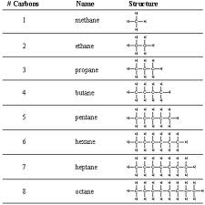
Organic Compounds
Organic Molecules
Contain the element carbon.
Many organic
molecules
contain long
chains of
carbon atoms.

Slide 49
Organic Compounds
Simple Organic Molecules
Functional Groups – Groups of atoms that can attach to the carbon chain of an orgainic molecule.
OH (hydroxyl group) – If it is found in an organic molecules, it becomes an alcohol.

